Slide 1
Option FMCW-Radar
Classical RADARs are based on pulse-echo-technique
- distance determination by Time-of-Flight (ToF) measurement
- see https://de.wikipedia.org/wiki/Radar => „Impulsradar“ => animation
Disadvantages of pulse-echo-RADARs
- long radio range requires high power (short) Tx-pulses
- high range resolution requires very short-time pulses
One solution: FMCW-RADAR
Tobias Otto, „Principles of FMCW Radars“, TU Delft,
see http://de.slideshare.net/tobiasotto/principle-of-fmcw-radars.
slides 1-7: principle of FMCW radar
slide 15: block diagram of an FMCW radar
slide 12: FMCW radar signal processing

Slide 2

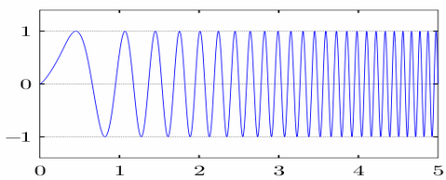
FMCW-Radar: how it works
range R=?
Time-of-Flight
t_{ToF} = 2∙R/c
dynamic or
static target
f
Slope of frequency ramp
s = B_{sweep}/T_{sweep}
modulation
B_{sweep} e.g. 260 MHz
f_{beat} = s·t_{ToF}
t_{ToF}
t
T_{sweep} e.g. 1 ms
T_{sweep} = N_{FFT·}T_{s}
T_{rep}
detection of f_{beat} or t_{TOF} or range R

Slide 3
FMCW-Radar Parameters
FMCW-Radar: frequency-difference f_{beat} ~ range R
  Exercise: find f_{beat} = …………………………………………………
  CW-Radar: frequency-difference f_{d} ~ Doppler-velocity
Rx-signal is multiplied with Tx-signal inside sensor
  frequency-difference appears at the sensor-outputs
  e.g: I(t) = A·cos(2π·f_{beat}·t-φ₀)
  detection of frequency difference f_{beat} with FFT of length N_{FFT}
Range-resolution ∆R = c / (2∙B_{sweep})
  e.g: B_{sweep} = 260 MHz => ∆R = 0.6 m
  Independent of ramp slope S and FFT-length N_{FFT}

Slide 4
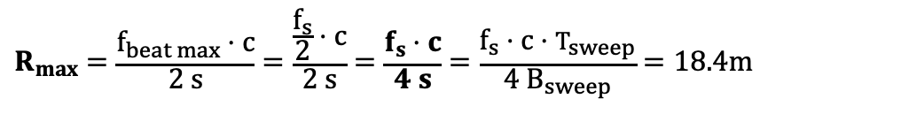
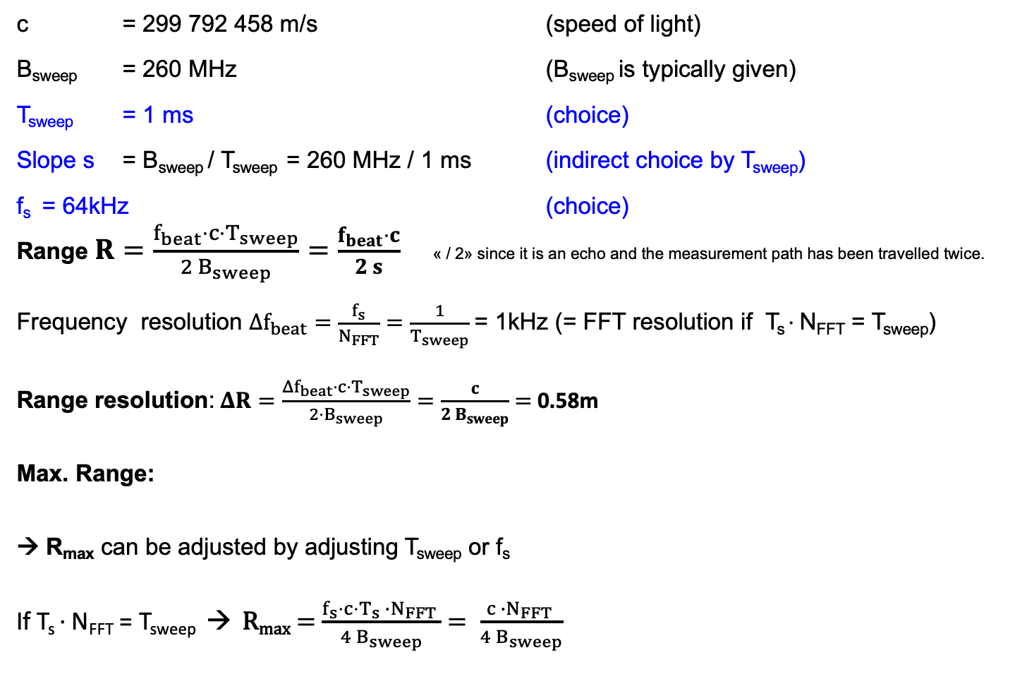
FMCW-Radar Parameters
c = 299 792 458 m/s (speed of light)
B_{sweep} = 260 MHz (B_{sweep} is typically given)
T_{sweep} = 1 ms (choice)
Slope s = B_{sweep} / T_{sweep} = 260 MHz / 1 ms (indirect choice by T_{sweep})
f_{s} = 64kHz (choice)
Range $R=\frac{f_{beat}⋅{c⋅T}_{sweep}}{2 B_{sweep}}=\frac{f_{beat}⋅c}{2 s}$ « / 2» since it is an echo and the measurement path has been travelled twice.
Frequency resolution $Δf_{beat}=\frac{f_{s}}{N_{FFT}}=\frac{1}{T_{sweep}}$= 1kHz (= FFT resolution if T_{s} ∙ N_{FFT} = T_{sweep})
Range resolution:$ΔR=\frac{{Δf}_{beat}⋅{c⋅T}_{sweep}}{2⋅B_{sweep}}=\frac{c}{2{ B}_{sweep}}$ $=$0.58m
Max. Range:
→ R_{max} can be adjusted by adjusting T_{sweep} or f_{s}
If T_{s} ∙ N_{FFT} = T_{sweep} → R_{max} = $\frac{f_{s}⋅c⋅T_{s} ∙N_{FFT} }{4 B_{sweep}}$ $= \frac{c ∙N_{FFT} }{4 B_{sweep}}$
$$R_{max}=\frac{f_{beat max}⋅c}{2 s}=\frac{\frac{f_{s}}{2}⋅c}{2 s}=\frac{f_{s}⋅c}{4 s}=\frac{f_{s}⋅c⋅T_{sweep}}{4 B_{sweep}}=18.4m$$

Slide 5
Additional FMCW-HW-Requirements
DAC generates sawtooth-signal for VCO-input
  Anti-Imaging-filter: RC-TP 1. order (f_{g} = 10 kHz) is sufficient
  VCO-Input voltage range: 0 bis 3.3 V
  VCO-Input impedance 20 kΩ
Sampling of sensor signal I(t) (and maybe Q(t))
  Support of f_{s} up to 100 kHz
  Bandwidth of analog Gain-Amplifier up to 50 kHz
  Gain-Bandwidth-Product of PM4-OpAmp is 2 MHz
  => 2 amplifier stages are required!
start of f-ramp and FFT-block must be «synchronized»

